Slide 1
Overview of Databases

Slide 2
Table of content
Overview of Database
Database Management System (DBMS)
Brief History
DBMS Architecture
Data Independence
Integrity Constraints

Slide 3
Overview of Database
A database is a structured collection of data that is organized and stored in a systematic manner to facilitate efficient data management and retrieval. It is designed to store, manage, and manipulate large volumes of data in a consistent and secure manner. Databases are widely used in various industries and domains to handle vast amounts of information effectively.
Databases provide a structured way to organize and store data. Data is typically organized into tables, which consist of rows (records) and columns (attributes). The structure and organization of data within a database are defined by its schema, which specifies the tables, columns, relationships, and constraints.
Databases offer mechanisms for creating, updating, and deleting data. They provide a set of operations, such as inserting new records, modifying existing records, and deleting unwanted data.
Databases enable efficient querying and retrieval of data. They support a query language (e.g., SQL) that allows users to specify search criteria and retrieve desired information from the database.

Slide 4
What is Data
Data: Data refers to raw facts, figures, or symbols that represent various attributes or characteristics. It consists of unprocessed, unorganized, and unstructured elements.
Data can exist in different forms, such as numbers, text, images, audio, or video.
Examples of data include individual measurements, observations, or records of transactions.
In the context of a database, data is typically stored in tables composed of rows (records) and columns (attributes). Each cell within the table represents a discrete piece of data.
For example, in a database of employees, a row may contain data such as employee ID, name, age, and department, with each column representing a specific attribute.

Slide 5
What is information
Information: Information, on the other hand, is the result of processing and organizing data in a meaningful way to provide context, relevance, and value.
It is data that has been processed, analyzed, and interpreted to generate insights, knowledge, or understanding.
Information is derived from data through the application of various processes, such as sorting, filtering, aggregating, and analyzing.
In the context of a database, information is generated by querying and analyzing the stored data.
For example, running a query to retrieve the names and ages of all employees above a certain age threshold would generate information that can be used for decision-making or reporting purposes.

Slide 6
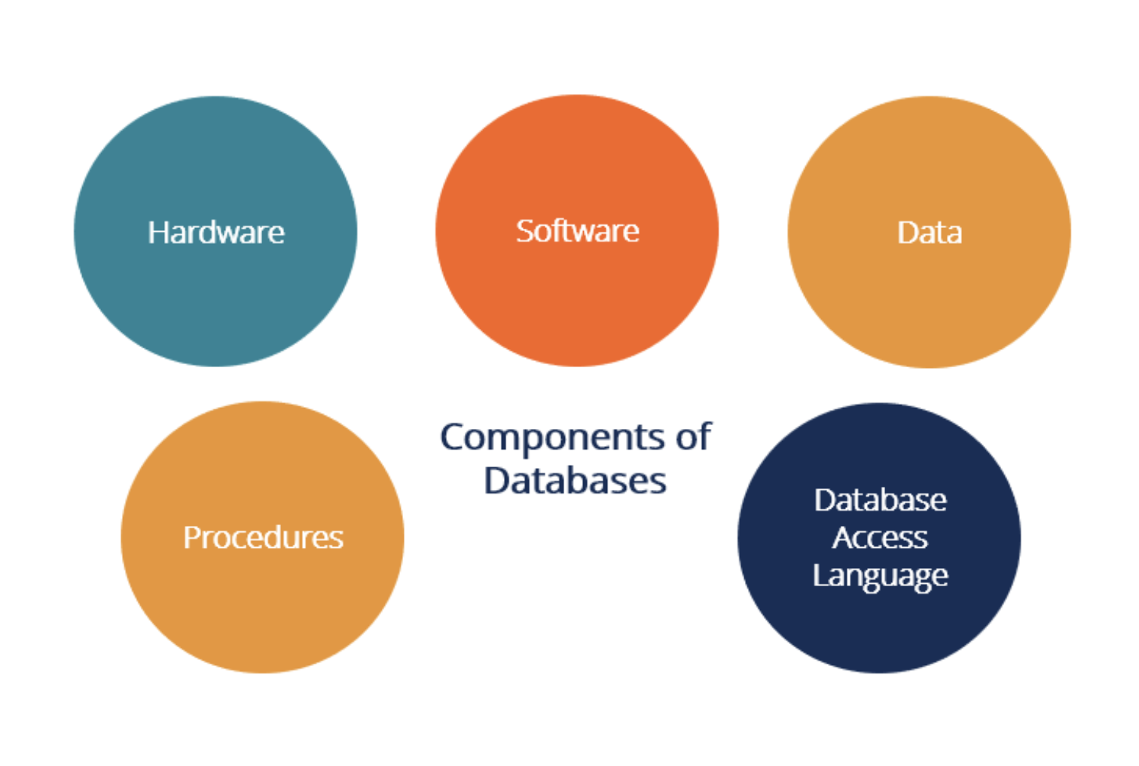
Components of Databases

Slide 7
Introduction to Database Management System
•DBMS stands for Database Management System. The software application allows users to efficiently store, manage, and retrieve data in a structured format.
•DBMS serves as an intermediary between the user and the database, providing a convenient way to interact with data.
•The primary function of a DBMS is to provide an organized and controlled environment for creating, storing, and manipulating databases.
•DBMSs are widely used in various domains, including business applications, scientific research, e-commerce, finance, and more.
•They provide a scalable, reliable, and efficient way to manage and utilize large volumes of data, enabling organizations to make informed decisions and derive valuable insights from their data.

Slide 8
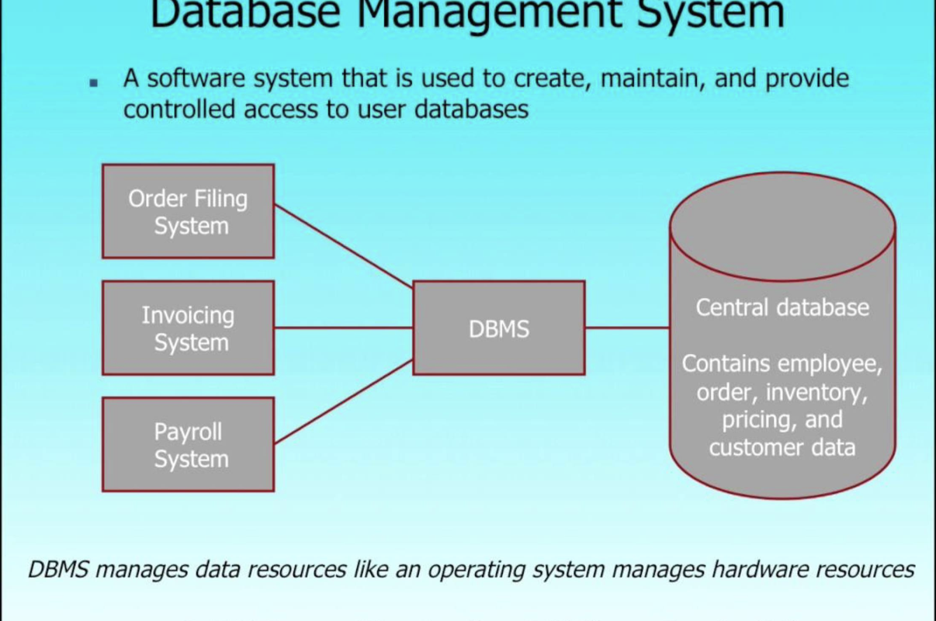
Introduction to Database Management System

Slide 9
Brief history
1960s: The concept of organizing and managing data in a structured way began in the 1960s.
1970s: In the 1970s, the relational model was introduced by E.F. Codd, a researcher at IBM. Codd's paper on "A Relational Model of Data for Large Shared Data Banks" laid the foundation for relational databases.
1980s: The 1980s saw the emergence of standardized query language for interacting with databases, known as SQL (Structured Query Language).
1990s: In the 1990s, the popularity of RDBMS continued to grow, and commercial database systems like Oracle, Microsoft SQL Server, and MySQL became widely used.
2000s: The 2000s saw the rise of NoSQL databases, which deviated from the traditional relational model.
2010s: In recent years, there has been a growing focus on handling and analyzing big data. Technologies like Apache Hadoop and Apache Spark emerged as distributed computing frameworks for processing and analyzing vast amounts of data across clusters of computers.

Slide 10
Why use Database?
Data Independence and efficient access.
Reduced application development time.
Data integrity and security
Uniform data administration
Concurrent access, recovery from crashes.

Slide 11
DBMS Architecture
2-tier architecture
3-tier architecture

Slide 12
Data Independence
Data independence is a concept in database management systems (DBMS) that allows the logical and physical aspects of the database to be separated.
Data independence is achieved through the use of a data abstraction layer provided by the DBMS. Data independence is achieved through the use of a data abstraction layer provided by the DBMS.
There are two types of data independence:
Logical Data Independence: Logical data independence ensures that the conceptual schema or logical view of the database can be modified without impacting the external schema or user applications.
It allows for changes in the organization, structure, or relationships of the data, such as adding, modifying, or deleting tables, columns, or relationships, without requiring changes to the applications that access the data.
This type of independence is important in maintaining the long-term usability and adaptability of the database as business requirements evolve.

Slide 13
Data Independence : Physical Data Independence
Physical Data Independence: Physical data independence enables changes in the physical storage and access methods of the data without affecting the logical schema or user applications.
It allows for modifications to the physical organization of the data, such as moving or redistributing data across storage devices, changing indexing or partitioning strategies, or altering data storage formats.
Physical data independence ensures that the underlying physical implementation details can be modified or optimized without requiring changes to the logical schema or user applications.
With physical data independence, the DBMS provides an abstraction layer that shields the users and applications from the specific details of how the data is stored on disk or accessed by the system.
Storage Format: The DBMS can change the storage format or encoding of the data without impacting the logical schema.
Indexing and Partitioning: The DBMS can modify the indexing or partitioning strategies used to optimize data access and query performance.
Data Replication: The DBMS can introduce data replication mechanisms to enhance fault tolerance, availability, or performance.

Slide 14
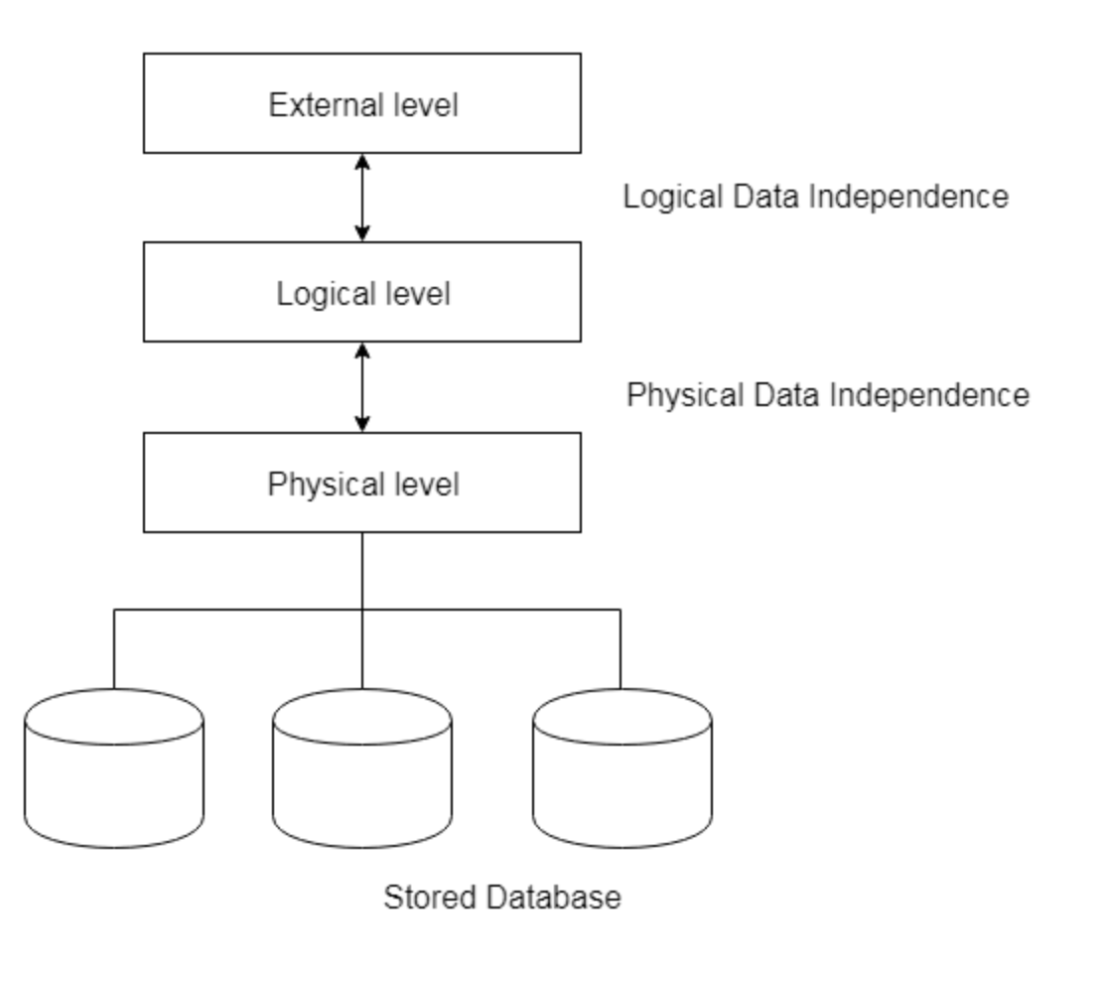
Data Independence : Physical Data Independence

Slide 15
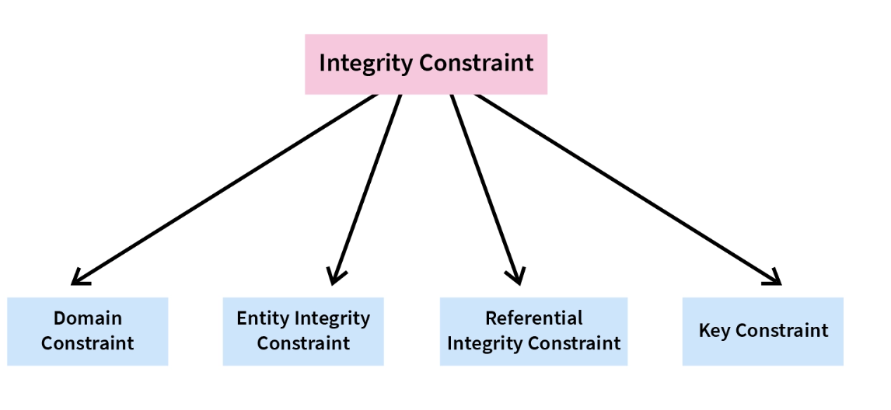
Integrity Constraints
Integrity constraints are rules or conditions that are defined on a database schema to ensure the accuracy, consistency, and validity of data stored in a database.
These constraints enforce rules and restrictions on the data, preventing the entry of invalid or inconsistent values and maintaining data integrity.
Integrity constraints are typically specified during the database design phase and are enforced by the database management system (DBMS) during data manipulation operations.

Slide 16
Integrity Constraints : Domain Constraint
A domain constraint specifies the valid range of values for a column based on its data type. It restricts the values that can be stored in a column to ensure data integrity.
In this example, the "Grade" column is restricted by a domain constraint that allows only the values "A", "B", "C", "D", "E", or "F".
Any other value inserted or updated in the "Grade" column would violate the domain constraint and result in an error.
studentID | name | age | gender | grade
1 | John | 16 | M | A
2 | Jane | 15 | F | B
3 | Mark | 17 | M | C

Slide 17
Integrity Constraints : Domain Constraint
The domain constraint ensures that the "Grade" column contains valid and appropriate values according to the defined domain.
It prevents the insertion of invalid or incorrect values that could compromise the integrity and meaning of the data.
By enforcing the domain constraint on the "Grade" column, the database management system guarantees that the stored data is consistent and aligned with the specified range of values.
This helps to maintain data quality and supports accurate reporting and analysis based on the defined domain of the column.
studentID | name | age | gender | grade
1 | John | 16 | M | A
2 | Jane | 15 | F | B
3 | Mark | 17 | M | C

Slide 18
Integrity Constraints : Entity Integrity Constraint
Entity integrity constraint, also known as entity key or entity uniqueness constraint, ensures that each row or entity in a table is uniquely identifiable by a primary key. .
It guarantees the uniqueness and non-nullity of the primary key values within a table.
In this example, the “studentID" column serves as the primary key. Each row in the “student" table has a unique studentID value, ensuring that no two students share the same identifier.
The entity integrity constraint guarantees the uniqueness and non-nullity of the primary key values, which is crucial for correctly identifying and distinguishing individual entities within the table
studentID | name | Email | Phone
1 | John | johndoe@example.com | 123-456-7890
2 | Jane | janesmith@example.com | 987-654-3210
3 | Mark | markbrown@example.com | 555-555-5555

Slide 19
Integrity Constraints : Referential Integrity Constraint
Referential integrity constraint is a rule that ensures the consistency and validity of relationships between tables in a relational database.
It maintains the integrity of foreign key relationships, enforcing that values in a foreign key column correspond to valid primary key values in the referenced table.
OrderID | CustomerID | OrderDate | TotalAmount
1 | 1 | 2023-05-10 | 100.00
2 | 2 | 2023-05-12 | 50.00
3 | 1 | 2023-05-15 | 75.00
CustomerID | Name | Email | Phone
1 | John | johndoe@example.com | 123-456-7890
2 | Jane | janesmith@example.com | 987-654-3210

Slide 20
Integrity Constraints : Referential Integrity Constraint
In this example, the "CustomerID" column in the "Orders" table is a foreign key that references the primary key "CustomerID" in the "Customers" table.
The referential integrity constraint ensures that the values in the "CustomerID" column of the "Orders" table correspond to valid and existing values in the "CustomerID" column of the "Customers" table.
In this example, the referential integrity constraint ensures that the values in the "CustomerID" column of the "Orders" table correspond to valid and existing primary key values in the "CustomerID" column of the "Customers" table.
It guarantees that every "CustomerID" value in the "Orders" table refers to an existing customer in the "Customers" table.
The referential integrity constraint prevents actions that would violate the integrity of the relationship, such as deleting a customer from the "Customers" table if there are corresponding orders in the "Orders" table.
By enforcing the referential integrity constraint, the database management system maintains the integrity of relationships between tables, supports accurate querying and joining of data, and helps prevent data inconsistencies and referential errors.

Slide 21
Integrity Constraints : Key Constraint
A key constraint, also known as a uniqueness constraint, ensures the uniqueness of values in one or more columns of a table.
It guarantees that the specified columns or combination of columns have distinct values for each row in the table.
Key constraints play a crucial role in maintaining data integrity and supporting data retrieval operations.
There are different types of key constraints:
Unique Key Constraint: A unique key constraint ensures that the values in the specified column or combination of columns are unique across the table. Unlike primary keys, unique keys allow for null values, but they still enforce uniqueness.
It guarantees that no two rows in the table have the same values in the specified column(s).
A unique key constraint ensures that the values in the specified column or combination of columns are unique across a table.
EmployeeID | EmployeeCode | Name | Department
1 | 1001 | John | Engineering
2 | 1002 | Jane | Sales
3 | 1003 | Mark | Marketing

Slide 22
Key Constraints : Primary Key Constraint
A primary key constraint is a key constraint that uniquely identifies each row or entity in a table.
It guarantees the uniqueness and non-nullity of the specified column(s) and serves as the primary means of identifying and accessing rows in a table.
The primary key constraint plays a fundamental role in maintaining data integrity and supporting relational database operations.
In this example, the "StudentID" column is designated as the primary key for the "Students" table. The primary key constraint ensures that each student in the table has a unique identifier.
In this example, the primary key constraint guarantees that each student in the "Students" table has a unique "StudentID" value. No two students can have the same "StudentID".
EmployeeID | Name | Age | Grade
1 | John | 18 | A
2 | Jane | 19 | B
3 | Mark | 20 | C

Slide 23
Key Constraints : Primary Key Constraint
The primary key constraint provides several benefits:
Uniqueness: It ensures that each row in the table has a unique identifier, preventing the insertion of duplicate values in the primary key column(s).
Non-nullity: It enforces that the primary key column(s) cannot contain null values, ensuring that each row has a valid identifier.
Data integrity: By enforcing uniqueness and non-nullity, the primary key constraint helps maintain the integrity and reliability of data stored in the table.
Relationship establishment: The primary key constraint serves as a reference point for establishing relationships with other tables using foreign keys. It allows for the creation of meaningful relationships between tables, enabling data consistency and referential integrity.
It's important to carefully select an appropriate column or combination of columns as the primary key, considering factors such as uniqueness, stability, and relevance to the data being stored. The primary key constraint is a fundamental aspect of relational database design and plays a critical role in data management and retrieval.

Slide 24
Key Constraints : Composite Key Constraint
A composite key constraint, also known as a composite primary key, is a key constraint that involves a combination of two or more columns to uniquely identify each row or entity in a table. Unlike a single-column primary key, a composite key uses multiple columns together to form a unique identifier.
This constraint ensures the uniqueness and non-nullity of the combined values in the specified columns.
In this example, the combination of "ISBN" and "PublicationYear" is designated as the composite primary key for the "Books" table. Together, these two columns uniquely identify each book in the table.
In this example, the composite key constraint ensures that each combination of "ISBN" and "PublicationYear" values in the "Books" table is unique. No two books can have the same combination of ISBN and PublicationYear.
ISBN | Title | Author | PublicationYear
978-0061122415 | To Kill a Mockingbird | Harper Lee | 1960
978-0142424179 | 1984 | George Orwell | 1949
978-0451524935 | Fahrenheit 451 | Ray Bradbury | 1953

Slide 25
Key Constraints : Composite Key Constraint
The composite key constraint provides several benefits:
Uniqueness: It ensures that the combination of specified columns has unique values for each row in the table, preventing the insertion of duplicate combinations.
Non-nullity: It enforces that the columns involved in the composite key cannot contain null values, ensuring that all components of the key are valid and present.
Complex identification: A composite key allows for the identification of rows based on multiple attributes or properties, capturing more nuanced and specific uniqueness requirements.
Relationship establishment: The composite key can be used as a reference in establishing relationships with other tables using foreign keys, enabling the establishment of meaningful and accurate relationships between related data.
When using a composite key, it's important to carefully choose the combination of columns based on their uniqueness and relevance to the data being stored. The composite key constraint ensures the integrity and uniqueness of data and enables efficient querying and manipulation of related records in a relational database.

